Slide 1
Analysis and Design of Algorithms

Slide 2
Course Outcomes
Design algorithms for various computing problems.
Analyze the time and space complexity of algorithms.
Critically analyze the different algorithm design techniques for a given problem.
Modify existing algorithms to improve efficiency.

Slide 3

Pre-requisites
Introductory courses on programming.
Data Structures

Slide 4
Text books/ Reference Books
Text Books:
Ellis Horowitz, Sartaj Sahani, Sanguthevar Rajashekaran, “Fundamentals of Computer Algorithms”, Orient Black Swan, 2nd Edition (2008).
Thomas H. Cormen, Charles E. Leiserson, Ronald L. Rivest and Clifford Stein, “Introduction to Algorithms”, MIT Press, 3rd Edition (July 31, 2009).
Reference Books:
J. Kleinberg and E. Tardos, “Algorithm Design”, Pearson,1 edition (29 August 2013)
Reference websites:
https://nptel.ac.in/courses/106101060/

Slide 5
Evaluation Scheme (Theory + Practical)
Particular | Allotted Percentage | Marks
Minor Test | 15% | 30
Major Test | 35% | 70
Continuous Evaluation Through Class Tests/Assignments | 10% | 20
Online Quiz | 5% | 10
Lab Work | 35% | 70
Lab Work
Particular | Marks
Regular evaluation | 50
Lab Work | 20

Slide 6
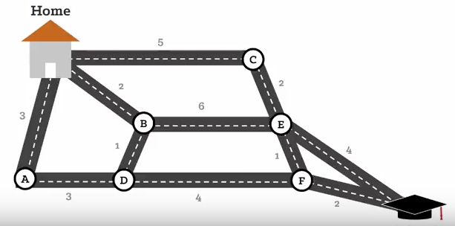
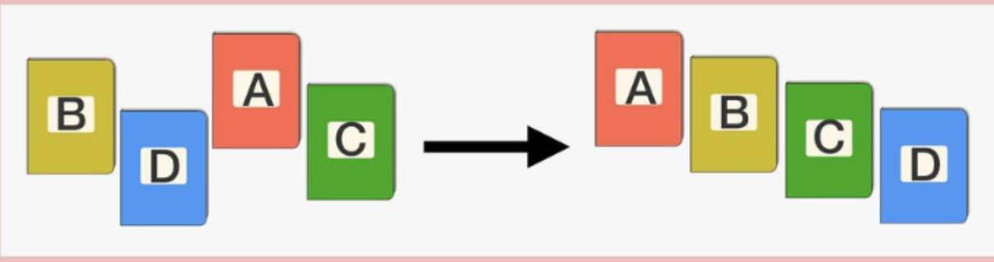
Motivation
We use algorithms all the time:
School arithmetic's: Long divisions addition with carry, square roots……..
Arranging books alphabetically on shelf.
Finding quickest route to the university.

Slide 7
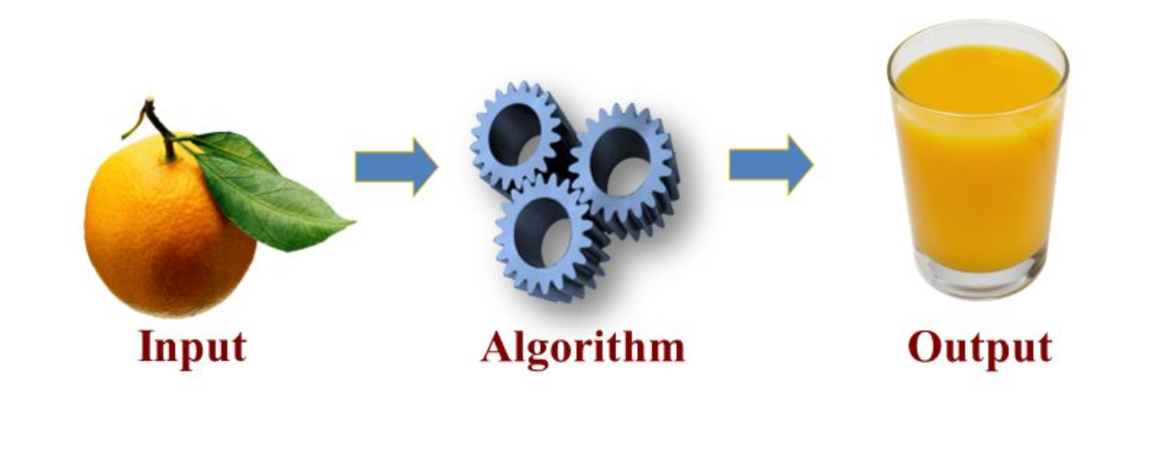
What is an algorithm?
A computer algorithm is a detailed set of instructions when executed sequentially then solve a problem in a finite amount of time.
Tool for solving a well specified computational problem.
Describes a specific computational procedure for achieving the desired output from a given input.

Slide 8

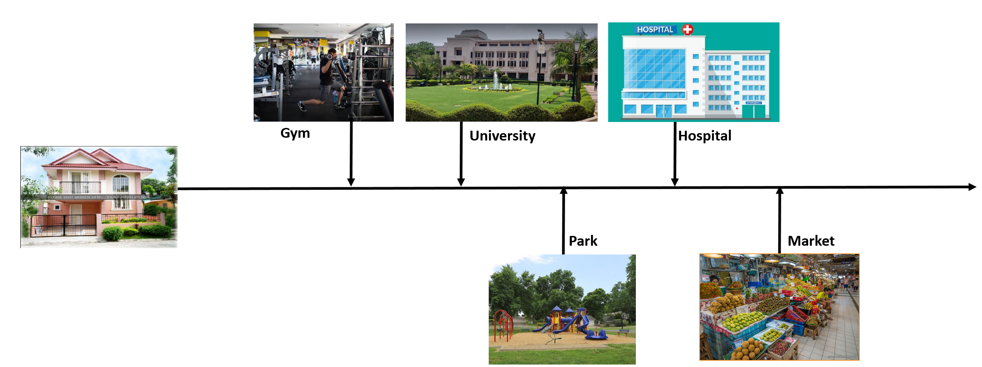
Algorithm to reach NCU

Slide 9

Algorithm
1. Go straight.
2. Take left turn.
3. You will reach NCU.
Take 2nd left turn.
(No ambiguity)
Which Left???

Slide 10
Characteristics of a good algorithm
Unambiguous
Effective/Correct
Termination
Defined set of inputs and outputs

Slide 11
How to design an algorithm?
Step 1: Obtain a description of the problem.
Step 2: Analyze the problem.
Step 3: Develop a high-level algorithm.
Step 4: Refine the algorithm by adding more detail.
Step 5: Review the algorithm.

Slide 12
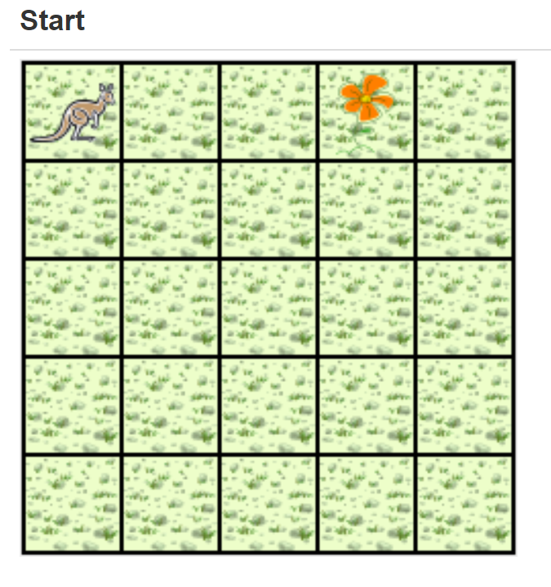
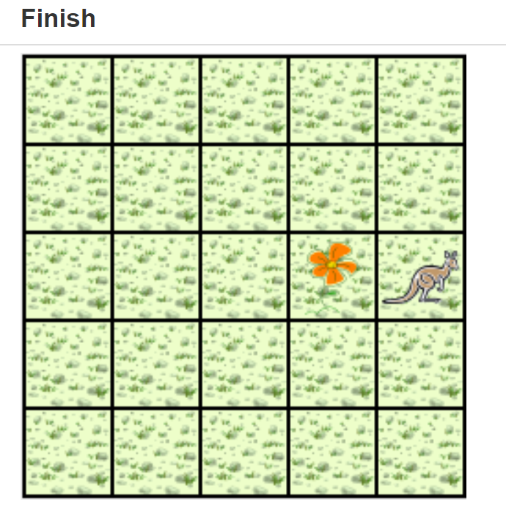
Problem statement (Step 1)
A Jeroo starts at (0, 0) facing East with no flowers in its pouch. There is a flower at location (3, 0). Write a program that directs the Jeroo to pick the flower and plant it at location (3, 2). After planting the flower, the Jeroo should hop one space East and stop. There are no other nets, flowers, or Jeroos on the island.
http://sofia.cs.vt.edu/cs1114-ebooklet/chapter4.html

Slide 13

Analysis of the Problem (Step 2)
The flower is exactly three spaces ahead of the jeroo.
The flower is to be planted exactly two spaces South of its current location.
The Jeroo is to finish facing East one space East of the planted flower.
There are no nets to worry about.

Slide 14
High-level Algorithm (Step 3)
Jeroo should do the following:
Get the flower
Put the flower
Hop East

Slide 15
Detailed Algorithm (Step 4)
Get the flower
Hop 3 times
Pick the flower
Put the flower
Turn right
Hop 2 times
Plant a flower
Hop East
Turn left
Hop once

Slide 16
Review the Algorithm (Step 5)
The high-level algorithm partitioned the problem into three rather easy sub-problems. This seems like a good technique.
This algorithm solves a very specific problem because the Jeroo and the flower are in very specific locations.
This algorithm is actually a solution to a slightly more general problem in which the Jeroo starts anywhere, and the flower is 3 spaces directly ahead of the Jeroo.

Slide 17
Computational Model
It is a mathematical model of a computer.
Mentally execute algorithm on model and evaluate time taken.
What is the time required on the model for every operation that an algorithm might perform?
What should be the input data?
In the field of runtime analysis of algorithms, computational model is specified in terms of primitive operations allowed, which have unit cost, or simply unit-cost operations.
Ex: External Memory Model (EMM), Random Access Machine (RAM).

Slide 18
Computational Model: EMM
In External Memory Model, the primary concern is the number of disk accesses.
Given the rather high cost of a disk access compared to any CPU operation, this model actually ignores all other costs and counts only the number of disk accesses.

Slide 19
Computational Model: RAM
Random Access Machine(RAM) has unit cost for read and write access to all of its memory cells.
All memory equally expensive to access
No concurrent operations
All reasonable instructions take unit time except, of course, function calls
Constant word size, unless we are explicitly manipulating bits
In this course will consider only Random Access Machine model where every primitive operation (all arithmetic operations) has unit cost.

Slide 20
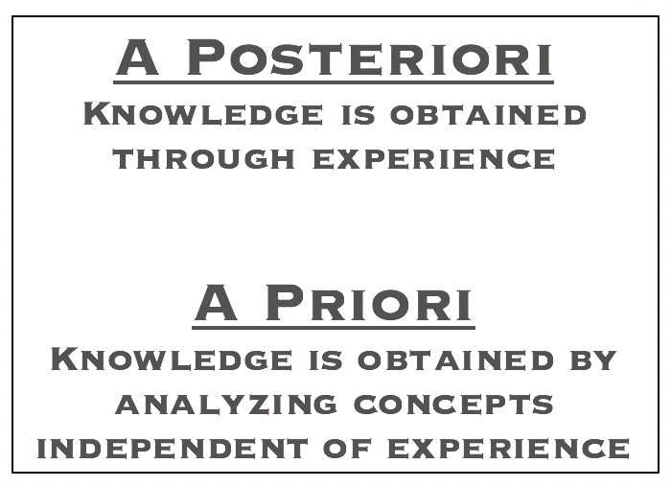
Performance analysis of algorithm
A Priori
A Posteriori

Slide 21
A Priori Vs A Posteriori analysis
A Priori
Piori analysis is an absolute analysis.
A Posteriori
It is dependent on language of compiler and type of hardware.
It is the reason we use asymptotic notations to determine time and space complexity as they change from computer to computer but asymptotically they are same.
Posteriori analysis is a relative analysis.
In industries, we cannot do A postiari analysis. As software is generally made for anonymous users who may run it on different systems (in processor like Pentium 3 or Pentium 4) from those present in the industry.
It is independent of language of compiler and types of hardware

Slide 22

Analysis of algorithm
Determination of the amount of time and space resources required to execute an algorithm.

Slide 23
Space Complexity
Space complexity is defined as the process of determining a formula for the production of how much memory space will be required for the successful execution of an algorithm.
The memory space we consider is the space of primary memory.

Slide 24

Time Complexity
The time complexity is defined as the process of determining a formula for total time required towards the execution of that algorithm.
Independent of the programming language selected for the implementation of the algorithm.

Slide 25

Importance of analysing algorithms
Need to recognize limitations of various algorithms for solving a problem.
Need to understand relationship between problem size and running time.
Need to learn how to analyze an algorithm's running time without coding it.
Need to learn techniques for writing more efficient code.

Slide 26
What do we analyze about them?
Correctness
Time and Space Complexity
Simplicity
Optimality

Slide 27
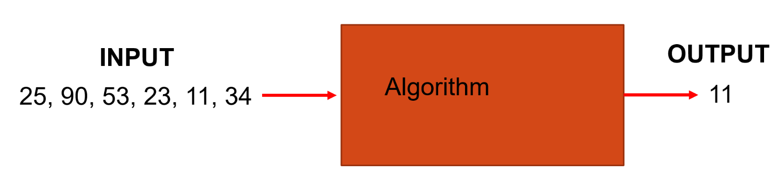
Example:
Problem: Input is a sequence of integers stored in an array.
Output: The minimum number in the array.

Slide 28
Solutions
Algorithm A Algorithm B
m← a[1]
For i ← 2 to size of input
if m>a[i] then m ← a[i];
Output m.
Copy the input a to array t1;
Assign n ← size of input;
While n > 1
for i ← 1 to n /2
t2[ i ] ← min (t1 [ 2*i ], t1[ 2*i + 1] );
copy array t2 to t1;
n ←n/2;
Output t2[0];

Slide 29
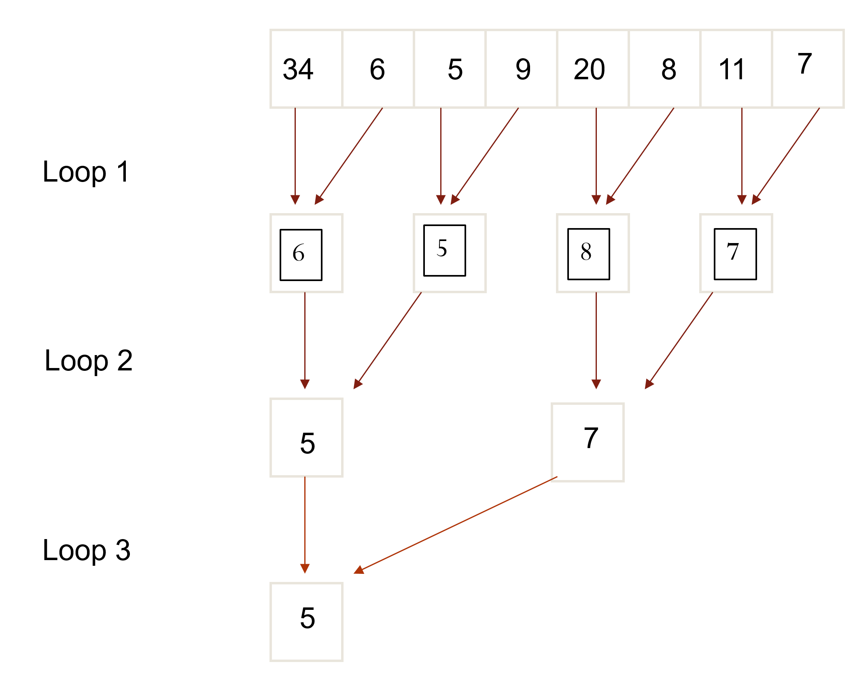
Visualisation of Algorithm B
This algorithm uses two temporary arrays.

Slide 30

Solutions Contd..
Algorithm C
i ← 0;
flag ← true;
While flag
i ← i+1;
min ← a[i];
flag ← false;
for j ← i to size of input
if min>a[j] then flag ← true;
Output min.
For each element, test whether it is the minimum.

Slide 31
Which algorithm is better?
All the algorithms are correct….
But which is the best??
Measure the running time (number of operations needed).
Measure the amount of memory used.
Note: The running time of the algorithms increase as the size of the
input increases.

Slide 32

Asymptotic Notations
Suppose we are considering two algorithms, A and B, for solving a given problem.
Running times of algorithm A = TA(n)
Running times of algorithm B = TB(n),
where n is a measure of the problem size.
If we know the problem size n in advance, then
if TA(n)< TB(n) Algorithm A is better than Algorithm B.
Unfortunately, we usually don't know the problem size beforehand.

Slide 33
Asymptotic Notations
Asymptotic notations allow us to analyze an algorithm’s running time by identifying its behavior as the input size for the algorithm increases.
Asymptotic – refers to study of function f as n approaches infinity
Example: f(n) = n²+4n + 20
n² is the dominant term and the term 4n + 20 becomes insignificant as n grows larger.
This is also known as an algorithm’s growth rate.

Slide 34
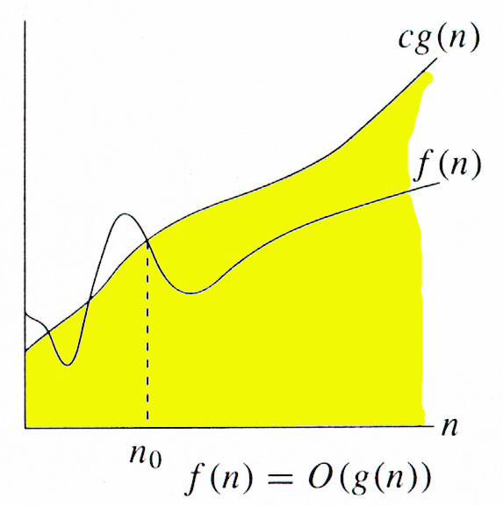
Big Oh Notation(O)
Definition:
f(n) = O(g(n))
if there are two positive constants c and n₀
such that:
|f(n)| ≤ c |g(n)| for all n ≥ n₀
g(n) is an asymptotic upper bound for f(n),
which means the growth rate of f(n) is no more
than the growth rate of g(n).
If f(n) = 2n²
g(n) is O(n³)

Slide 35

Points to remember
When determining the order of a function f(x), always try to pick the smallest g(x) possible.
If f(x) is Ο(g(x)) and g(x) is Ο(f(x)), then f(x) and g(x) are of the same order.
In practice, all big-O results are obtained for functions that are positive for all values of x

Slide 36
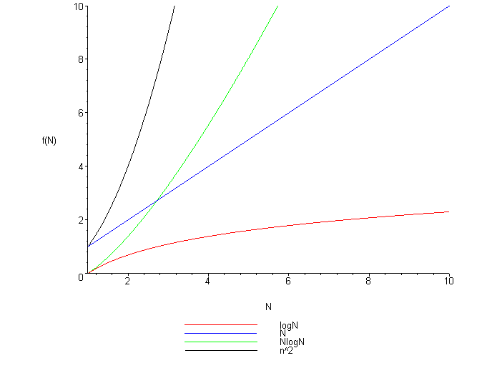
Most Common Big Oh Functions
Constant O(1)
Logarithmic O(log n)
Linear O(n)
Quadratic O(n²)
Polynomial O(n^{k}) k is a constant
Exponential O(2^{n})
Exponential O(a^{n}) a is a constant and a > 1

Slide 37
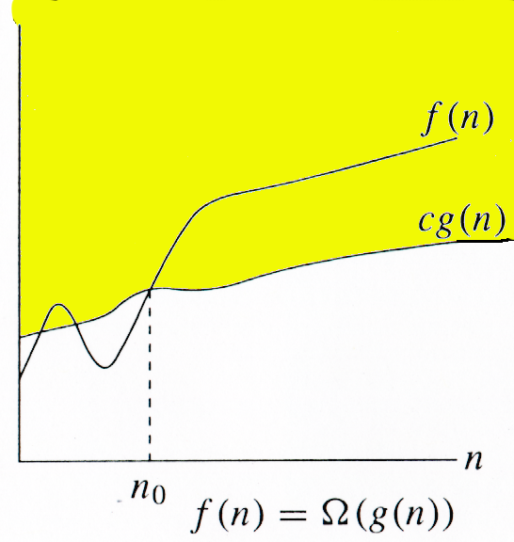
Omega Notation($Ω$)
Definition:
f(n) = Ω(g(n)
if there exist positive constants c and n₀
such that:
0 < c |g(n)| < |f(n)| for all n≥ n₀
g(n) is asymptotic lower bound for f(n), which
means the growth of f(n) is no lesser than the
growth rate of g(n).

Slide 38
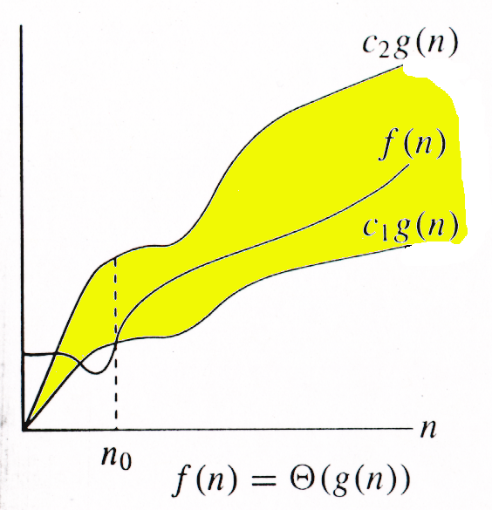
Theta Notation(Ɵ)
Definition:
f(n) = Ɵ (g(n))
if there are two positive constants c and n₀
such that:
0 ≤ c₁ g(n) ≤ f(n) ≤ c₂ g(n)
This is known as asymptotic tight bound. For reasonably large values of n, the function f(n) is within the range of constant multiples of g(n). f(n) is bounded below as well as above.

Slide 39
Practice questions
Practice Questions

